Slide 1

Illumina RNA and DNA library prep for mNGS
Rapid Response – Updated September 2026

Slide 2





mNGS pipeline
Study design
xNA extraction
Library prep
Sequencing
Data analysis
Pathogen ID
Type(s)
Controls
Storage
Lab setup
Type(s)
Controls
QC
Host removal
Fragmentation
dsDNA generation
End-repair
Adapter ligation
Barcoding & PCR
Clean-up
Pooling
QC
Machine
Read length
Loading conc.
QC data
Host removal
Alignment
Blast
Ranking of hits

Slide 3
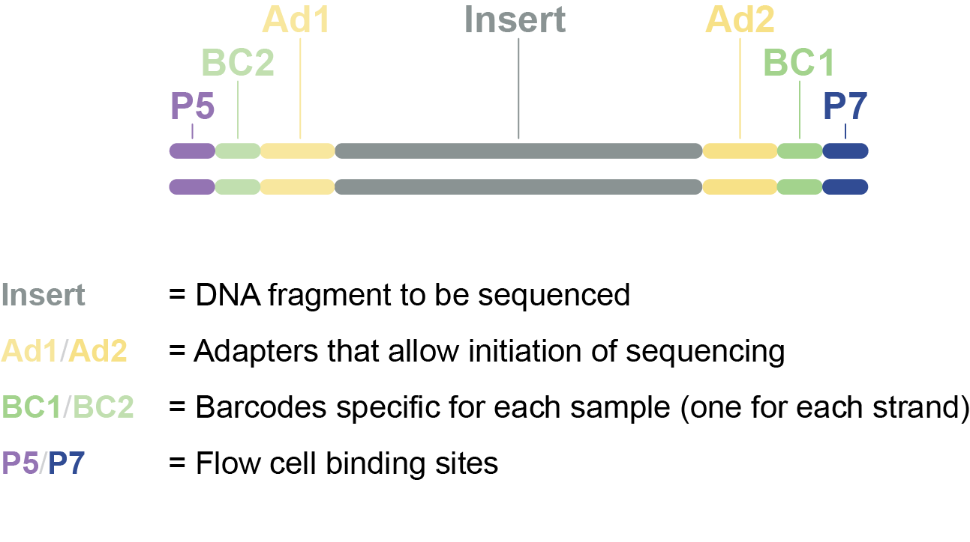
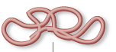
Library prep: RNA or DNA to sequencing library
Sequencing library = Pool of DNA inserts with sequencing adapters attached
Extracted RNA or DNA
Sequencing library

Slide 4
What is a sequencing library?
Sequencing library = Pool of DNA inserts with sequencing adapters attached

Slide 5
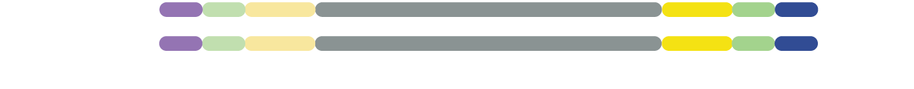
What is a sequencing library?
Sequencing process:
F
L
O
W
C
E
L
L
F
L
O
W
C
E
L
L
Read 1
Read 2
Notes:
Animation shows how your library is sequenced.

Slide 6
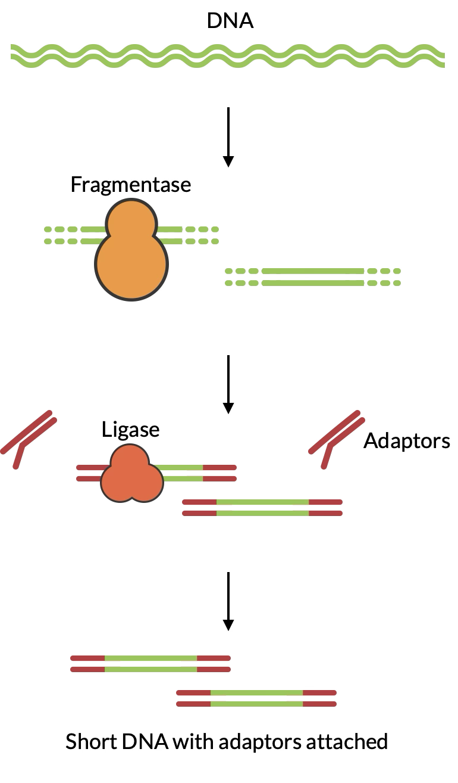
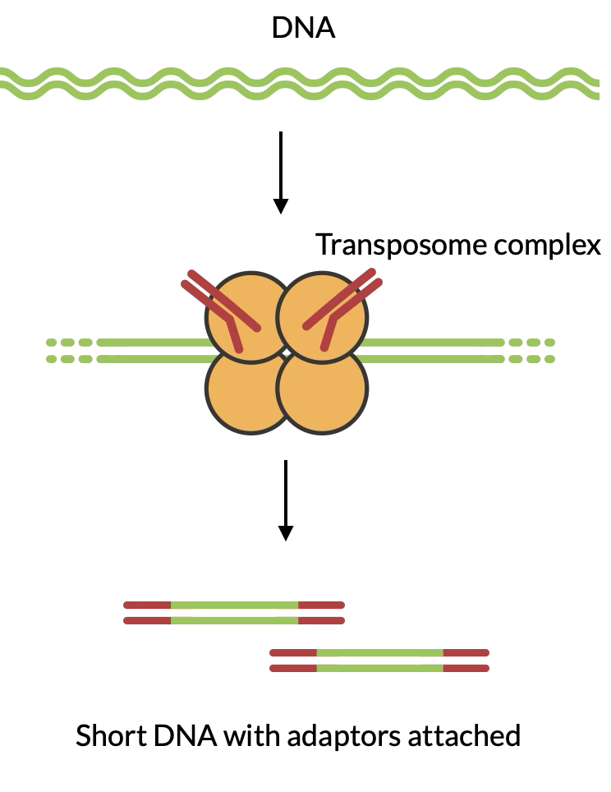
Two broad approaches to library preparation
Tagmentation
(fragmentation + adapter addition)
Fragmentation, then Adapter Ligation
Fragmentation

Slide 7
Two broad approaches to library preparation
Tagmentation
(fragmentation + adapter addition)
Fragmentation, then Adapter Ligation
Fragmentation

Slide 8
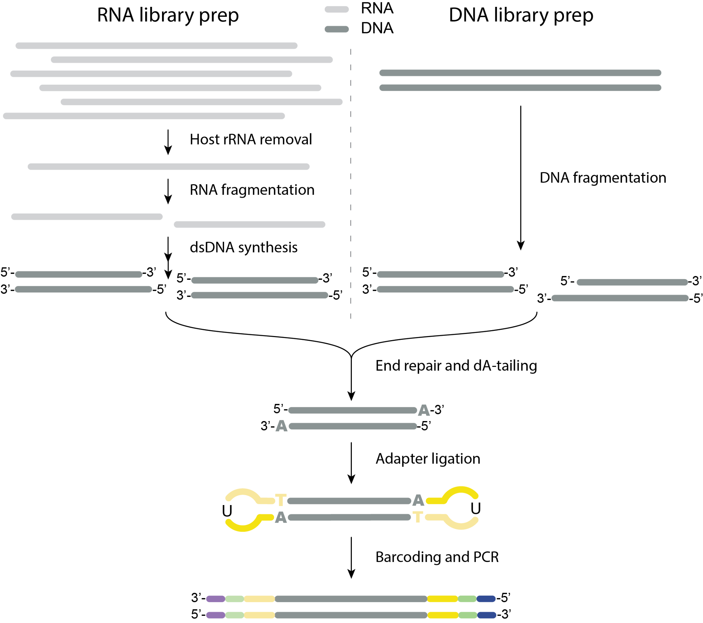
Library prep
Libraries are dsDNA
Notes:
RNA and DNA library prep steps. We’ll go into detail of RNA library prep since that is the more complicated one. And once you are familiar with RNA library prep, you’ll find DNA library prep to very similar but simpler.

Slide 9
Library prep
Starting with RNA requires additional steps to convert it into dsDNA
Notes:
RNA and DNA library prep steps. We’ll go into detail of RNA library prep since that is the more complicated one. And once you are familiar with RNA library prep, you’ll find DNA library prep to very similar but simpler.

Slide 10
Steps in library preparation:
1. Host depletion, RNA fragmentation + priming
2. First strand cDNA synthesis
3. Second strand cDNA synthesis
4. End Prep
5. Adapter Ligation
6.. USER + Barcoding PCR

Slide 11
RNA library prep
STEP 0. Starting material: RNA or TNA
RNA only: move on to host rRNA depletion
TNA (total nucleic acid): need to remove DNA
  Aliquot sample
  DNAse I treatment
  SPRI bead clean-up (2x)
  Qubit quantification
Notes:
If you extract RNA you can proceed to the next step. But if you extracted total nucleic acid, you’ll have to remove the DNA first. This can be achieved by DNAse I treatment

Slide 12
RNA library prep
RNA content of typical host sample
95% host rRNA
2-3% host mRNA
1% other host RNA
<1% pathogen RNA
STEP 1. Host rRNA depletion
Before RNA extraction:
  Serum or plasma instead of blood
  Supernatant of CSF to remove WBCs
Human RNA depletion kits to use after RNA extraction:
  FastSelect (Qiagen): $50 for 24 samples when reagent is diluted 1:10
    Proprietary technology, presumably with hybridizing probes that make rRNA inaccessible to enzymes in subsequent steps
Notes:
Next step involves removing as much human host material as possible. The RNA content of a typical host sample will be 95% host rRNA, 2-3% host mRNA and 1% other host RNA. And then less than 1% usually is pathogen RNA. If you prepare a sequencing library from such a sample, all of these types of RNA would be sequenced, and only 1% of your reads would be from pathogens that you are interested in. So it’s important to first remove host rRNA as much as possible, to allow your pathogens take up more of the sequencing data.
FastSelect takes host rRNA from 95% to about 30% in our hands

Slide 13
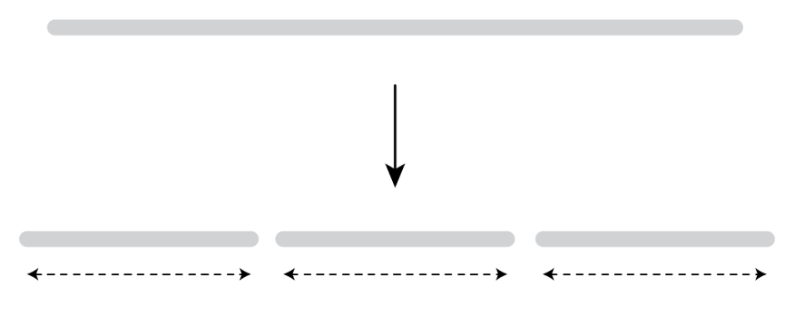
RNA library prep
STEP 2. Fragmentation
Ideal insert size = ± 400 nt
Several ways to fragment RNA:
  Enzymatic: %GC-dependent -> may bias mNGS results
  Heat cycling: relatively random
  Sonication: larger volume required, expensive machine, contamination risk
  Divalent cations: allow RNA to be self-cleaving (Mg²⁺, Ca²⁺, Zn²⁺, …)
    Mg²⁺ and heat (94ºC) for 2-15 minutes depending on RNA quality
      High quality RNA: long fragmentation time
      Low quality RNA: short fragmentation time
Fragmentation
± 400 nt
± 400 nt
± 400 nt
Notes:
FastSelect takes host rRNA from 95% to about 30% in our hands

Slide 14
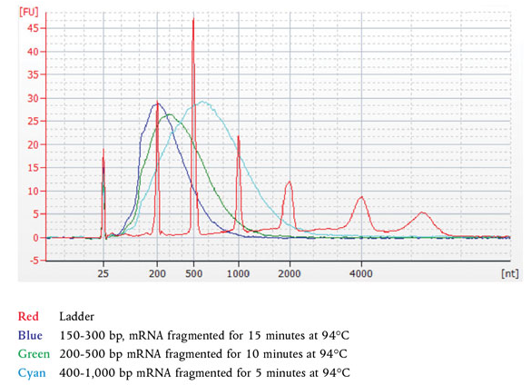
RNA library prep
Fragmentation pattern of high quality RNA
STEP 2. Fragmentation
Use shorter fragmentation times when RNA quality is compromised!
Electropherogram from BioAnalyzer
Notes:
From NEBNext Ultra II RNA First Strand Synthesis Module E7771 manual

Slide 15
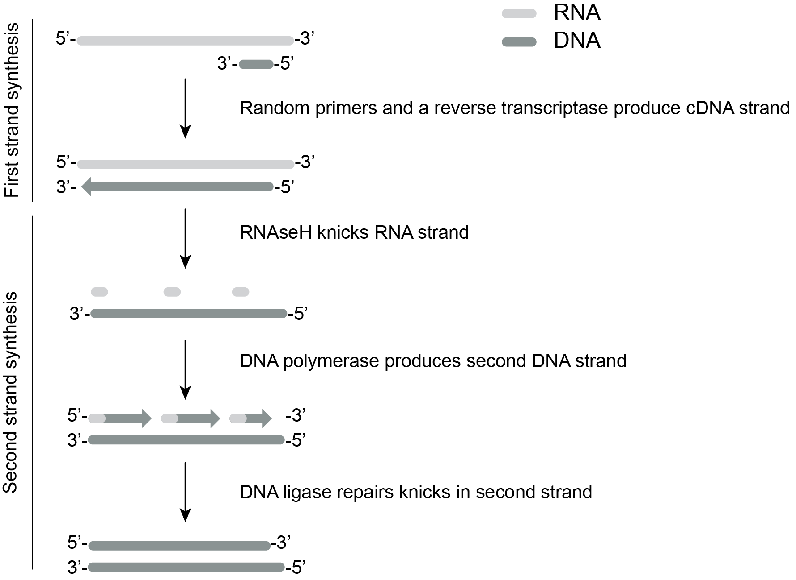
RNA library prep
STEP 3. dsDNA synthesis
First strand synthesis
Second strand synthesis
3. Purify dsDNA by SPRI bead clean-up (1.8x)
*Depending on the kit, dsDNA is already end repaired

Slide 16
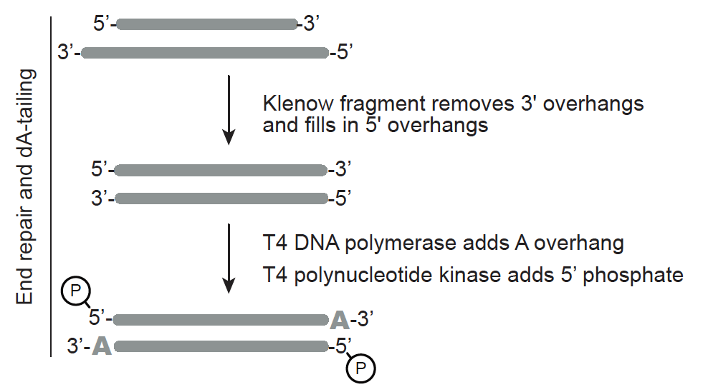
RNA library prep
STEP 4. End repair & dA-tailing
Remove overhangs to get blunt ends
Prep fragment to clone on adapters
  Add 5’ phosphate (T4 kinase)
  Add single 3’ A overhang to clone on adapters
(T4 DNA polymerase)
  Note: After end-repair, move on to adapter ligation step ASAP
  (5’ phosphate is fragile)
*Some kits obviate this step, the repair occurs during dsDNA synthesis

Slide 17
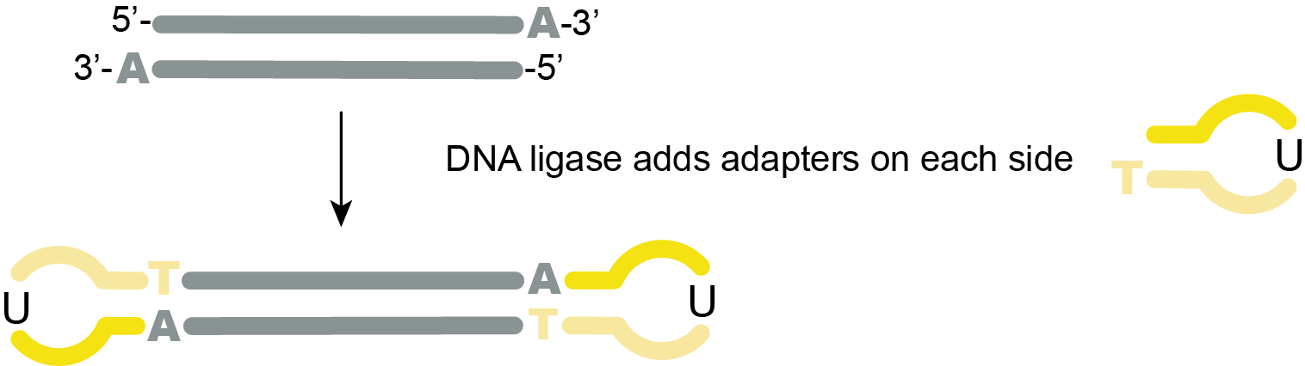

RNA library prep
STEP 5. Adapter ligation
Adapters are added to allow sequencing
Remove adapter dimers by SPRI bead clean-up (0.9x)
  Adapter dimers are our enemy #1 after this step (short fragments get preferentially sequenced)
Notes:
Enhancer is likely DMSO + PEG8000 for crowding/increase local concentration so adapters and dsDNA find each other more easily
Takes 15 minutes, but can do 1hr if really really low input quantity.
If 5% adapter dimer in library, it will take up 20% of your sequences in the end.
Adapter dimers at this stage are about 64 bp long

Slide 18
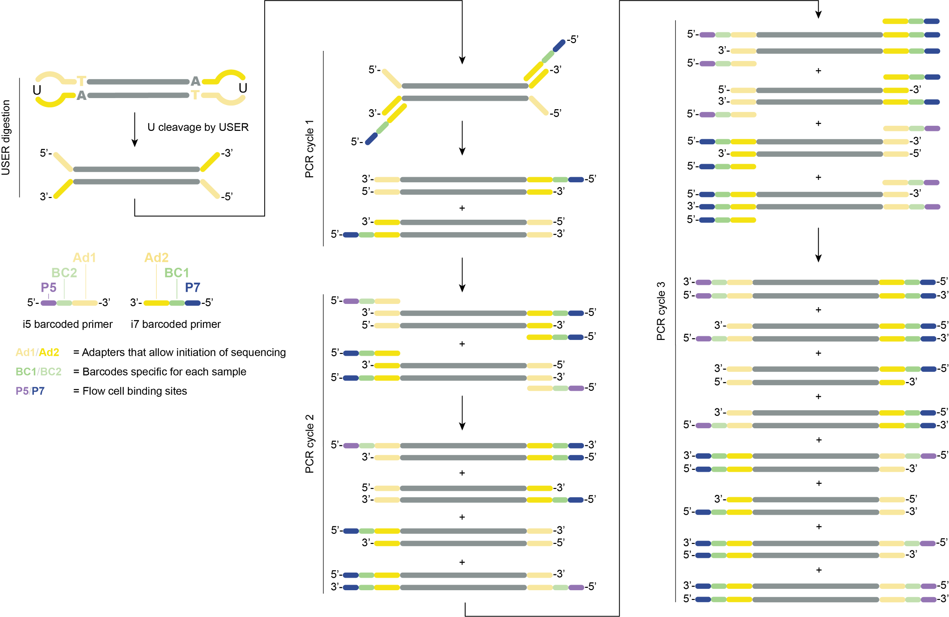
RNA library prep
STEP 6.
Barcoding PCR
i5 and i7 oligos are added by PCR, along with unique barcodes per sample
SPRI bead clean-up (0.8x)
Denaturation
5’-
- 3’
3’-
- 5’
...
Notes:
Reduce #PCR cycles to the absolute minimum to avoid amplification bias.

Slide 19
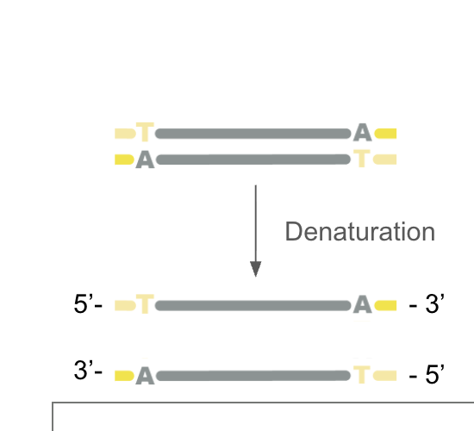
RNA library prep
STEP 6.
Barcoding PCR
i5 and i7 oligos are added by PCR, along with unique barcodes per sample
SPRI bead clean-up (0.8x)
...
Notes:
Reduce #PCR cycles to the absolute minimum to avoid amplification bias.

Slide 20
RNA library prep
STEP 6.
Barcoding PCR
i5 and i7 oligos are added by PCR, along with unique barcodes per sample
SPRI bead clean-up (0.8x)
...
Notes:
Reduce #PCR cycles to the absolute minimum to avoid amplification bias.

Slide 21
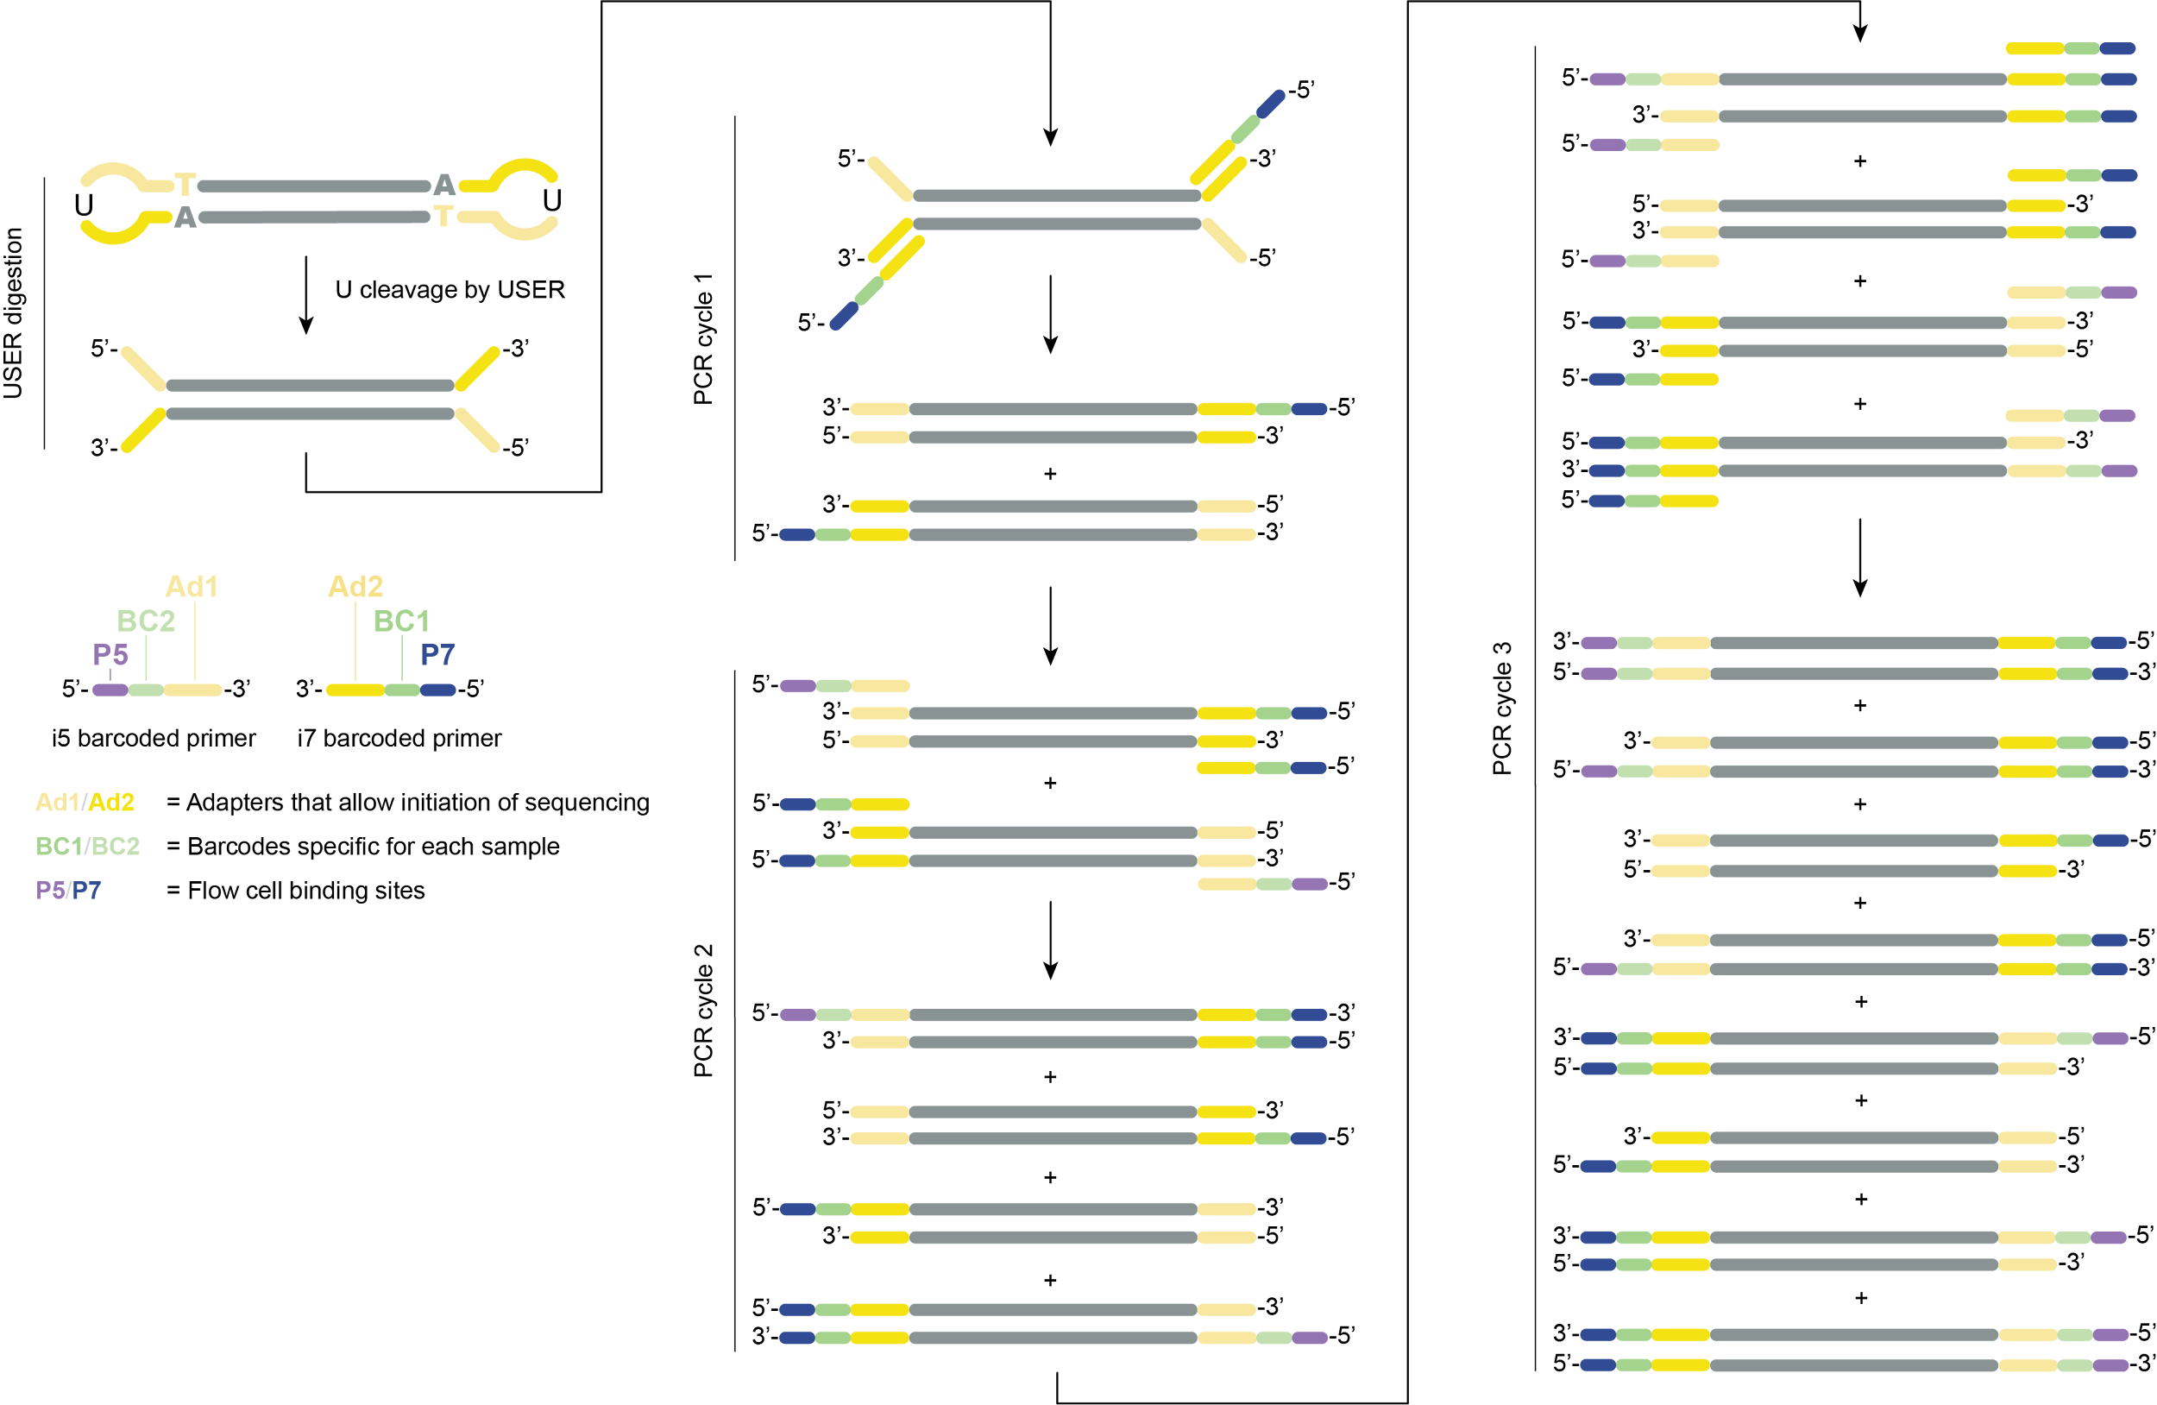
RNA library prep
STEP 6.
Barcoding PCR
i5 and i7 oligos are added by PCR
SPRI bead clean-up (0.8x)
...
Notes:
Reduce #PCR cycles to the absolute minimum to avoid amplification bias.

Slide 22
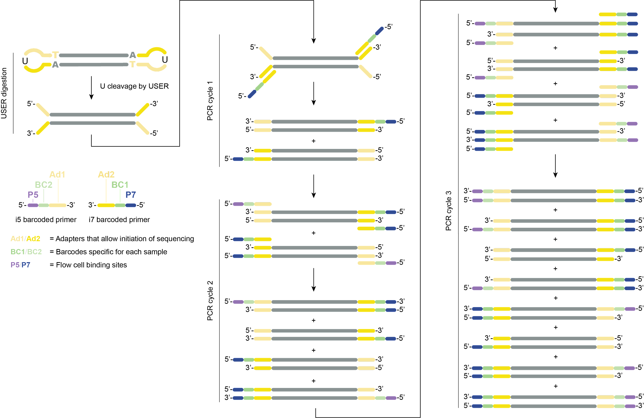
RNA library prep
Note on alternative adapters, such as the NEB U shaped
Adapter dimers must be removed
Barcoding PCR starts with USER digestion
Notes:
Enhancer is likely DMSO + PEG8000 for crowding/increase local concentration so adapters and dsDNA find eachother more easily
Takes 15 minutes, but can do 1hr if really really low input quantity.
If 5% adapter dimer in library, it will take up 20% of your sequences in the end.
Adapter dimers at this stage are about 64 bp long

Slide 23
RNA to sequencing library
Extracted RNA
Sequencing library

Slide 24
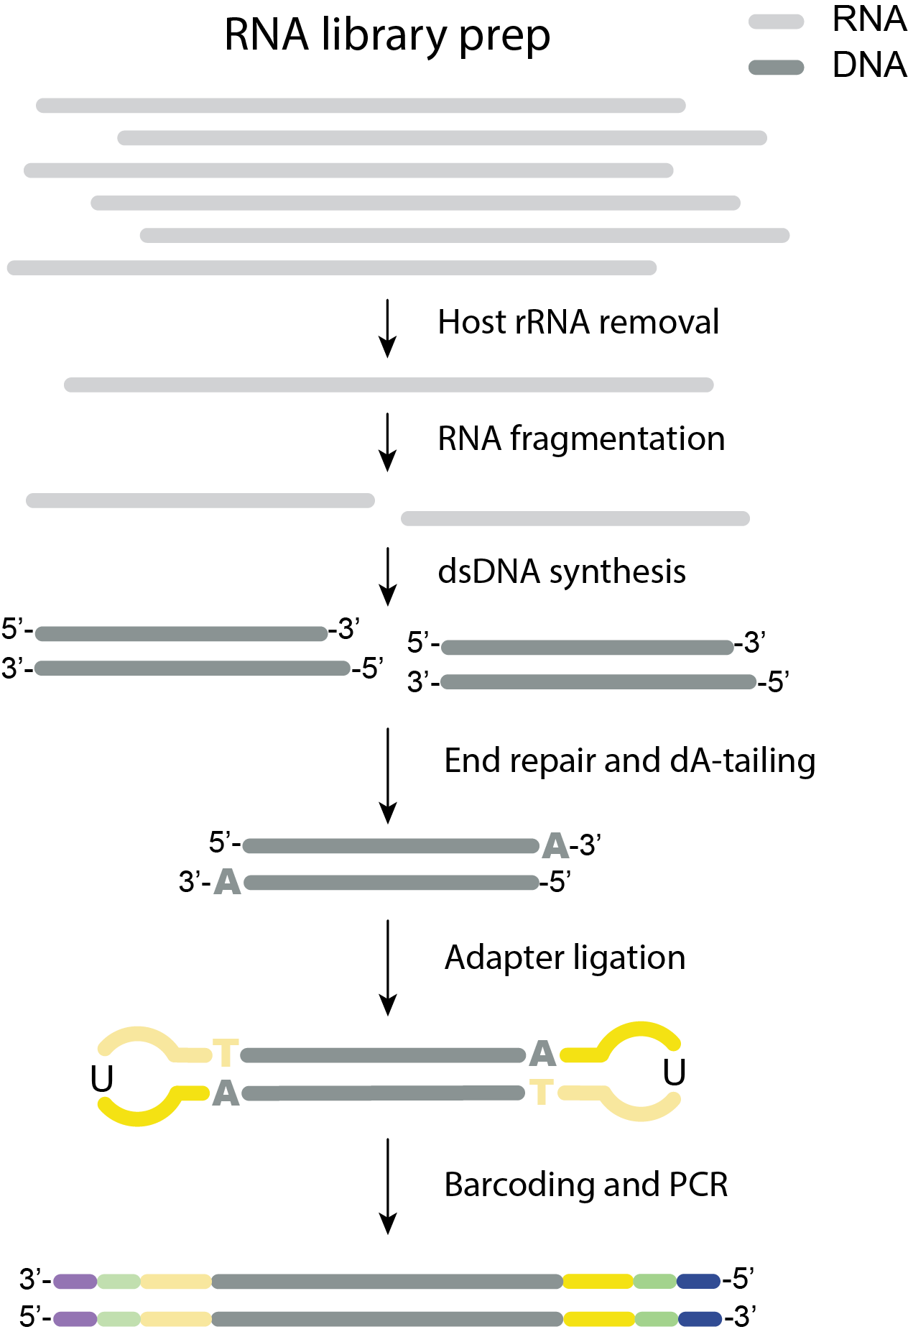
DNA library prep
DNA library kit options
gDNA or cDNA
NEBNext
Ultra II FS DNA
Illumina
DNA Prep
WGS, cDNA, amplicons
Illumina
Nextera XT
(small genomes, cDNA, amplicons)
Fragmentation
1 rxn,
Transposome frag. + ligation on bead
1 rxn,
Transposome frag. + ligation in solution
1 rxn,
Fragm. enzyme + repair enzymes
1 rxn, U shaped adapters
1 rxn
1 rxn
1 rxn
Notes:
DNA library prep follows the same steps as RNA library prep, except that the RT step is not required and that fragmentation happens enzymatically or by a transposome (instead of Mg2+ and heat for RNA library prep)

Slide 25
RNA library kit options
NEBNext
Ultra II RNA
Illumina rapid
total RNA prep
After rRNA depletion cDNA synthesis and tagmentation occur simultaneously ~3.5 hr
Watchmaker RNA kit
1 rxn,
fragm. by Mg²⁺ & heat
1 rxn,
fragm. by Mg²⁺ & heat
1 rxn for 1st str. synt.
1 rxn for 2nd str. synt.
1 rxn for 1st str. synt.
1 rxn for 2nd str. synt.
SPRI bead cleanup
Watchmaker advantages
~4x input material
1 Rx less: 2ND SS & End repair are combined
1 less cleanup
The use of miniadapters leads to smaller AD and more efficient clean-ups
1 rxn, adapter ligation (miniadapters)
1 rxn
SPRI bead cleanup
1 rxn, U shaped adapters
1 rxn Barcoding PCR
SPRI bead cleanup
SPRI bead cleanup
1 rxn with an extra enzymatic
step to digest the “U”
SPRI bead cleanup
Notes:
We’ll use the NEBNextUltra II RNA kit as an example

Slide 26
RNA library prep
Goal:
To make RNA and/or DNA Libraries that are compatible with Illumina sequencers
Workflow:
Very similar preparations between the 2 libraries but multiple steps required to make RNA into double stranded DNA.
Considerations:
How can we accurately assess composition of a sample of known input? ERCC spike ins
How do we sequence many samples at once? Barcoding libraries and then pooling. Careful of mixing barcodes or samples pre-barcoding.
Optimal insert length 400-500bp. Fragmentation of RNA/DNA is varied by time. How long for fragmentation to get the optimal insert size?
To reduce PCR amplification bias, reduce PCR cycles to the minimal needed for sequencing (6-19 cycles)

Slide 27
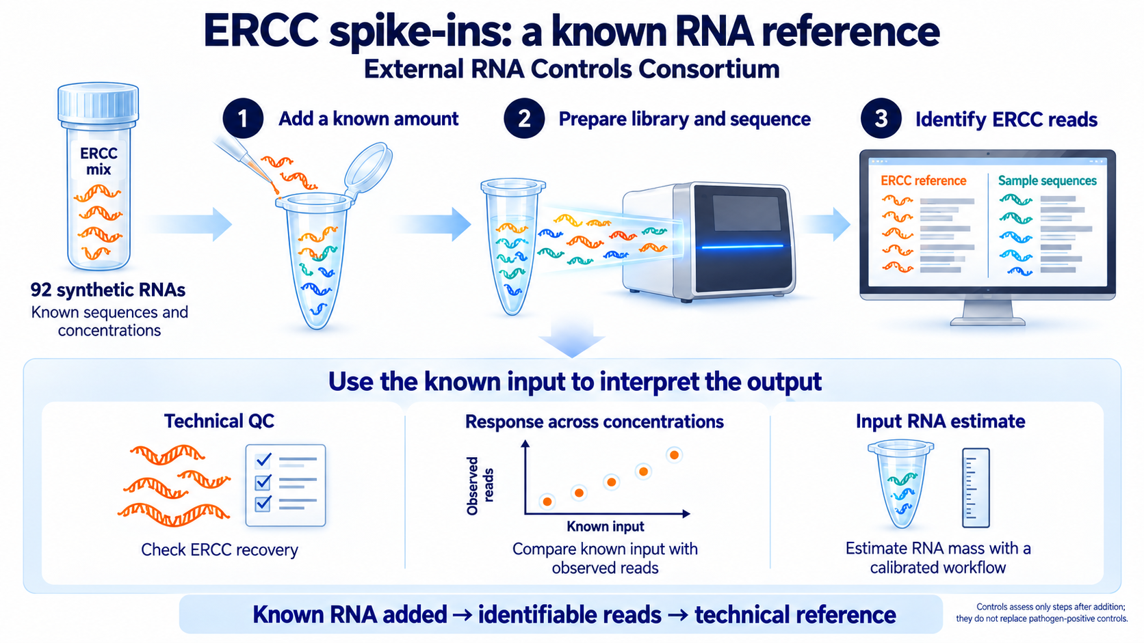
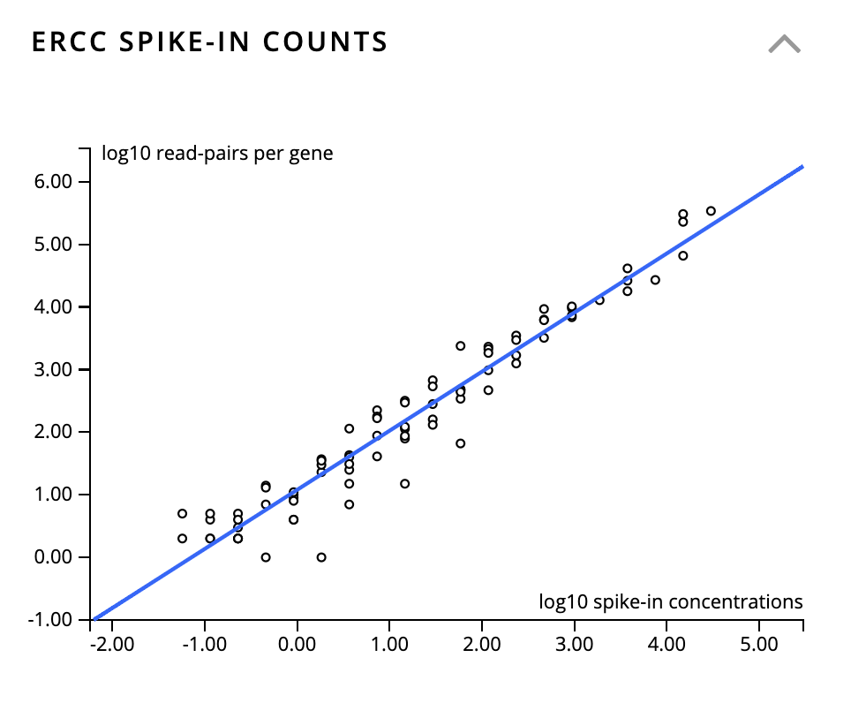
Synthetic standards for RNA library QC
ERCCs = External RNA Controls Consortium
Pre-mixed, commercially available blend of 92 synthetic RNA transcripts
Positive control for library preparation, spiked-in for all samples and water controls
Can be used to estimate input RNA concentration
Plot generated from CZ ID

Slide 28
Introduction to
SPRI Clean-ups

Slide 29
What are SPRI beads?
Solid-phase Reversible Immobilization (SPRI) beads are paramagnetic beads used for purification and size selection of nucleic acids such as:
  PCR amplicons
  NGS libraries
  RNA/DNA

Slide 30
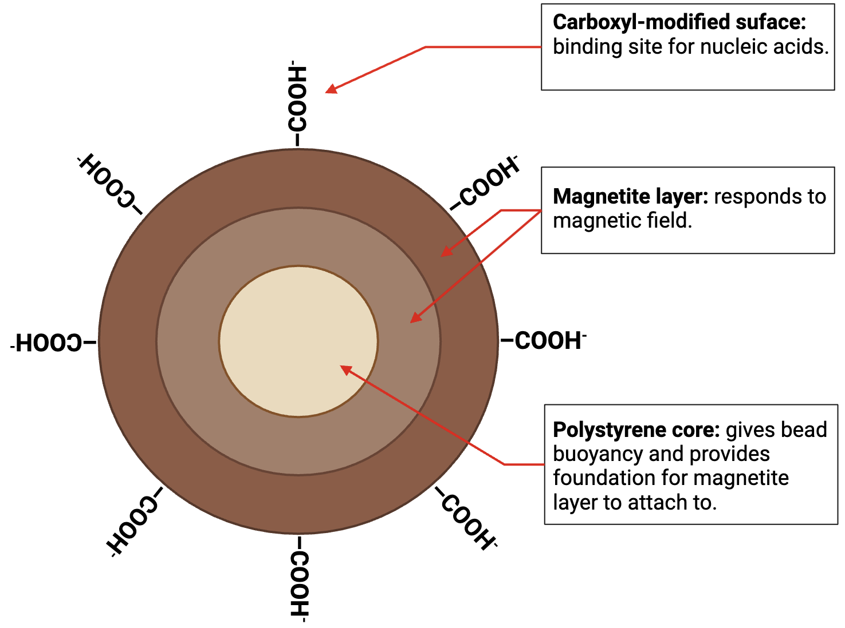
What are SPRI beads?

Slide 31
How do SPRI beads work? Purification
Under the right conditions, nucleic acids precipitate on the surface of the beads. The following are required:
  Crowding agent to force nucleic acids out of solution.
  High salt concentration to facilitate binding between nucleic acids and beads.
  Magnetic field induction to control movement of nucleic acids.

Slide 32
Contents of SPRI buffer
Content | Use
Polyethylene Glycol (PEG) 8000 | Crowding agent used to minimize space between nucleic acid and beads, favoring their proximity and the nucleic acid precipitating on the surface of the beads.

Slide 33
Contents of SPRI buffer
Content | Use
Polyethylene Glycol (PEG) 8000 | Crowding agent used to minimize space between nucleic acid and beads, favoring their proximity and the nucleic acid precipitating on the surface of the beads.
NaCl | Decreases solubility of nucleic acid, thereby promoting precipitation of nucleic acid on the surface of the beads.

Slide 34
Contents of SPRI buffer
Content | Use
Polyethylene Glycol (PEG) 8000 | Crowding agent used to minimize space between nucleic acid and beads, favoring their proximity and the nucleic acid precipitating on the surface of the beads.
NaCl | Decreases solubility of nucleic acid, thereby promoting precipitation of nucleic acid on the surface of the beads.
Tris-HCl | Regulates pH.

Slide 35
Contents of SPRI buffer
Content | Use
Polyethylene Glycol (PEG) 8000 | Crowding agent used to minimize space between nucleic acid and beads, favoring their proximity and the nucleic acid precipitating on the surface of the beads.
NaCl | Decreases solubility of nucleic acid, thereby promoting precipitation of nucleic acid on the surface of the beads.
Tris-HCl | Regulates pH.
EDTA | Chelating agent which sequesters ions such as Mg2+ and Ca2+ which could fragment/degrade DNA or activate any enzymes (e.g. nucleases) that are present in the sample. Aids in retaining the integrity of the sample.

Slide 36
Contents of SPRI buffer
Content | Use
Polyethylene Glycol (PEG) 8000 | Crowding agent used to minimize space between nucleic acid and beads, favoring their proximity and the nucleic acid precipitating on the surface of the beads.
NaCl | Decreases solubility of nucleic acid, thereby promoting precipitation of nucleic acid on the surface of the beads.
Tris-HCl | Regulates pH.
EDTA | Chelating agent which sequesters ions such as Mg2+ and Ca2+ which could fragment/degrade DNA or activate any enzymes (e.g. nucleases) that are present in the sample. Aids in retaining the integrity of the sample.
Tween 20 | Detergent which decreases the adhesion of nucleic acids to the plastic walls of the tube by obstructing the ionic attraction.

Slide 37
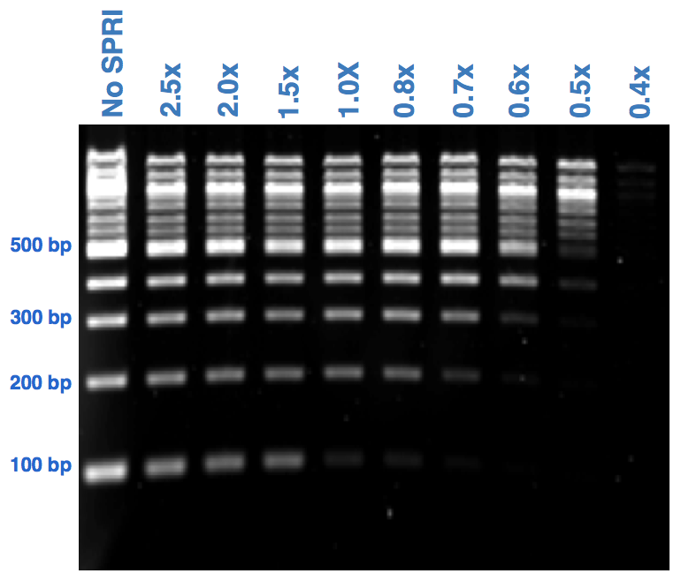
How do SPRI beads work? Size selection
Size selection is dictated by the ratio between the volume of SPRI beads added to your sample and the volume of your sample.
  The higher the SPRI bead to sample volume ratio, the more smaller fragments will be retained.
For a desired SPRI ratio, to determine the volume of SPRI beads to add to your sample, multiply the SPRI ratio by the volume of your sample.
Volume of beads
Volume of reaction
SPRI ratio =

Slide 38
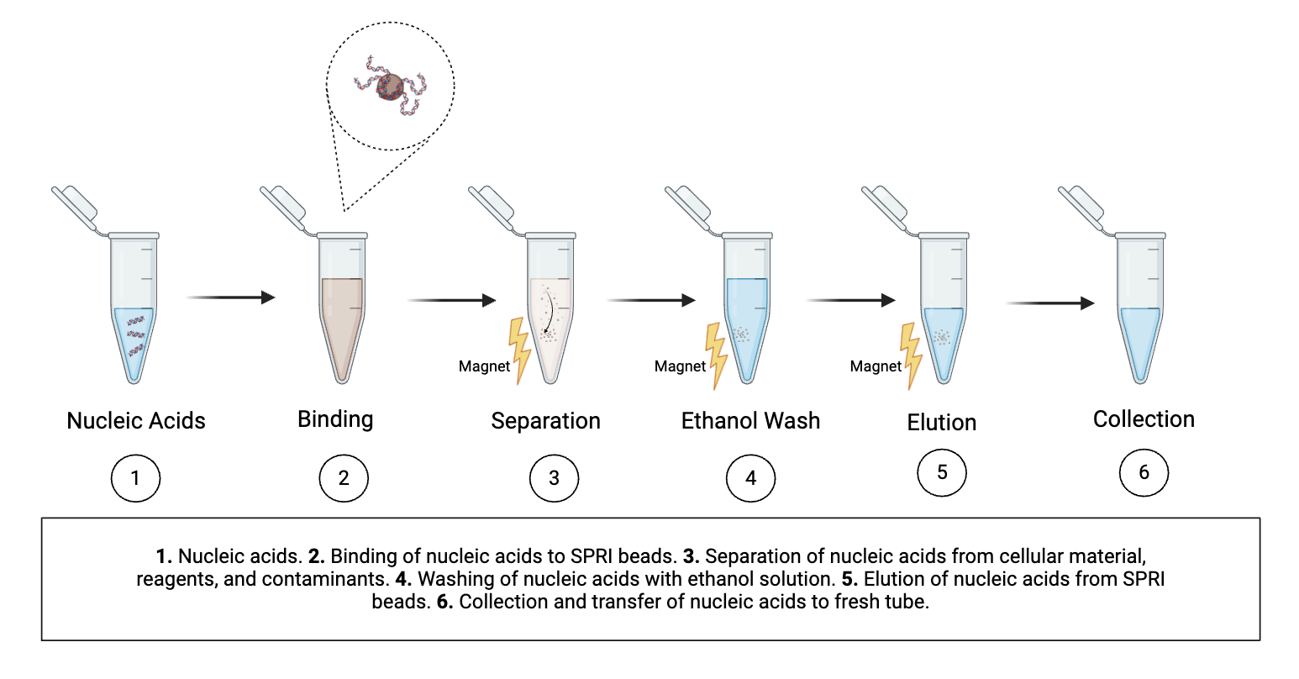
Using SPRI beads in library preparation: The process
Note: Some commercial options are “SPRISelect Bead-Based Reagent” or “AMPure XP Beads”

Slide 39
Using SPRI beads in library preparation: At which steps?
Step | Ideal RNA/library size | To remove | SPRI ratio
After DNAse I treatment | - | Reagents | 2x
After barcoding PCR | > 400 bp | Reagents and small fragments / dimers | 0.6x
After pooling (if the pool needs to be concentrated | - | To concentrate the pool before loading | 2x
Volume of beads
Volume of reaction
SPRI ratio =
Notes:
P7: 24 nt p7 + 12 nt barcode + 2 nt + 32 nt adapter compl.
P5: 20 nt p5 + 9 nt +12 nt barcode + 33 nt adapter compl.

Slide 40
SPRI bead cleanup activity
Set up 2 reactions according to the table below at 0.8X and 2.0X. DNA input is 50bp DNA ladder diluted to 1:50 (save an aliquot to use as a control).
Add SPRI beads to sample and mix thoroughly by pipetting up and down ten times. Incubate for 3-5 mins at room temperature, then pulse spin the tubes for 1-2 seconds,
Place samples on magnetic rack and incubate for ~5 mins on the rack.
Remove supernatant.
Add 200μL of 85% EtOH to samples while on the magnetic rack. Do not disturb beads. Incubate at room temperature for 30s then remove the supernatant.
Repeat EtOH wash step for a total of 2 washes.
Air dry the beads for up to 3-5 mins while on the magnetic rack. Watch beads carefully throughout this incubation to avoid overdrying; smaller bead pellets dry faster. Trust your eyes more than the timer.
Remove tube from magnetic rack. Add 20ul nuclease free water to elute.
Pipette to mix well at least ten times. Incubate for a minimum of 2 mins at room temperature off the magnetic rack, then pulse spin the tubes for 1-2 seconds.
Place on magnetic rack until solution is clear ~5 mins.
Collect 18ul of the supernatant and transfer to a clean nuclease free PCR tube
Bead:Sample | 0.8 : 1 | 2 : 1
50bp ladder 1:50 (μL) | 20 | 20
SPRI beads (μL) | 16 | 40

Slide 41
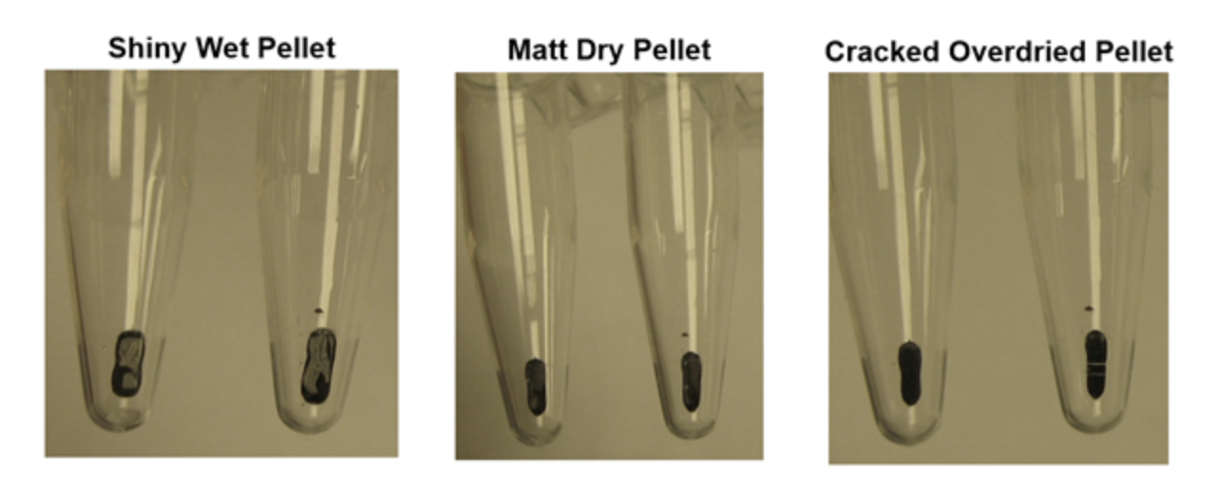
Do not overdry SPRI beads
Shiny, wet pellet Matte, dry pellet Cracked, overdried pellet
Risk of EtOH carryover
Ready for elution
Risk of low yield

Slide 42
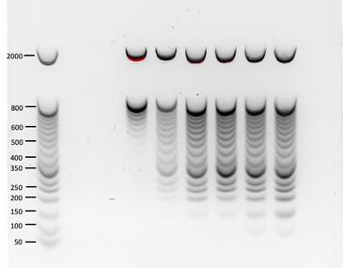
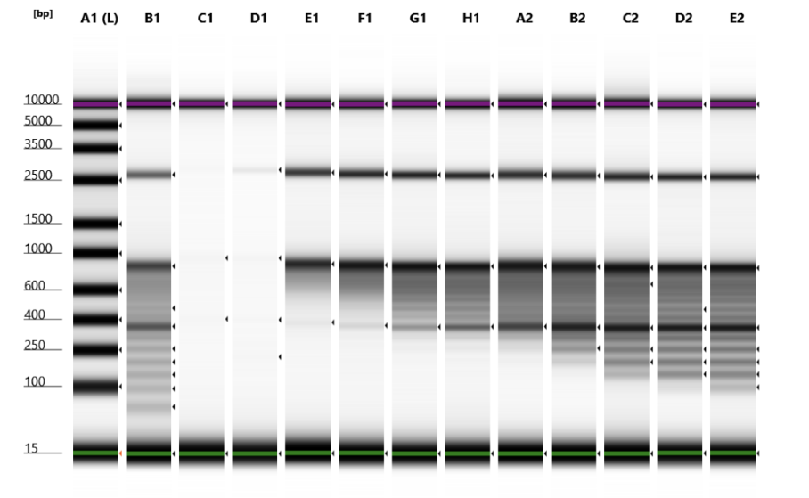
SPRI bead cleanup results
Quantify recovered sample by Qubit dsDNA HS
Visualize samples by agarose gel electrophoresis (1.8% agarose gel and 10000x SYBR GOLD DNA Stain or SYBR-Safe stain), capillary electrophoresis, or automated electrophoresis (TapeStation).
Ladder 0.35 0.5 0.7 0.9 1.1 1.4 1.7 2.0
Ladder 50bp 0.35 0.5 0.7 0.75 0.8 0.85 0.9 1.1 1.4 1.7 2.0
1.8% Agarose
TapeStation

Slide 43
Next: 05-I_Library prep QC for Illumina

